Slide 1
WELCOME

Slide 2
Retail Store
Management System

Slide 3

Points:
Introduction
Objective
Existing system
Proposed System
Scope And Feasibility
Needs of Store Management System
Software Requirements
Hardware Requirements
Flow-Chart
Output Screenshots
Advantages and Disadvantages
Future Enhancement
Conclusion

Slide 4

Introduction
In Retail Store different-differents products are purchase from dealer and sale to the customer. Such Product as: Stationeries, Grocery product, Cosmetics like as many more products etc.
We have observed the increasing use of a computer-based system to keep records of the products, customers and records of Stock for each sale by various stores. The concept of preparing hand written records and bills is slowly being replaced by the computer-based stock managing system. Thus, there is an increased demand of such systems in the market.
In this project we can manage:
Add Customer Records
View Customer Report
Add Product
View Product Report
Search Product
Update Stock
This Photo by Unknown Author is licensed under CC BY

Slide 5

Objective
Main objective of this project is using information technology we can easily manage the Retail Store Management System. Now a day, in world every work is require fast.
In short time we can require bulk of work, and also manage many documentation records.
Develop an application with user friendly interface.
Provide the facility of adding, saving, editing and searching product details.
Provide the facility of searching records stored in database very quickly and flexibly.
The new system should be time efficient.
Efficiently manage a stock system.
The new system should maintain the record in neat and clean way.
Give access to authentic person only to manage user accounts.

Slide 6

Existing System
In the present situation, most business still continue to use the register-based records keeping system. Different register are used to keep product details, company details, sale records. Also, hand written report of sale.
Problems with the Existing System:
Manual System faces a lot of inefficiencies.
Needs manual calculations which are prone to errors.
Poor communication may lead to serious inadvertent errors.
Although more man power, but less efficiency.
Consumes large volume of paper work.
Lack of security of data.
Time consuming.

Slide 7
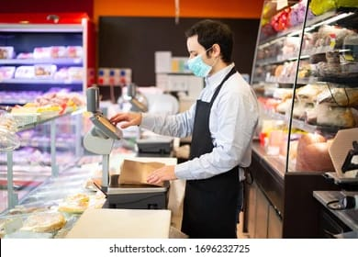
Proposed System
The Retail Store Management System maintains computerized Record of Customer Who visits, their product. It’s also perform quick search for their products, Manages Stock And Keep record of customers.
Benefits with the Proposed System:
Reduced Processing cost.
Automatic updation of product details.
Reduction of man power.
Reduction of use of paper.
Faster response.
Capital work.

Slide 8
Scope and feasibility
The Retail Store Management System for Shopkeepers is specifically designed to the needs of small to medium-sized retail Store operated by shopkeepers.
The system aims to provide a user-friendly and cost-effective solution to streamline daily operations, manage inventory efficiently, and enhance customer satisfaction.
The proposed system is ‘Retail Stores Management System’.
This system is GUI based system and is user friendly.
Retail Stores Management System is accessible through the internet. Stores are required for the following purposes.
1. Capital works and time efficient.
2. system should maintain the record in neat and clean way.
3. Other purposes like store information of Stock maintain daily records etc.

Slide 9
Needs of store management system
Inventory management: Tracking stock levels, managing products.
Customer management: Managing customer data.
Analytics and reporting: Generating product report.
Security: Implementing measures to protect customer data, prevent fraud, and ensure compliance with regulations.
Customization and scalability: Adapting the system to the specific needs of the retail store and ensuring it can accommodate future growth and changes.

Slide 10
Software requirements
Operating System: Windows /Linux
Web Server: Apache Tomcat Web Server
Database: MySQL
Implementation Architecture: Servlets, JSP
Frontend Language: HTML, CSS,
Scripting Languages: Java Script
Programming Language: Java
Hardware requirements
Intel Core i5 Processor
512MB or more.

Slide 11
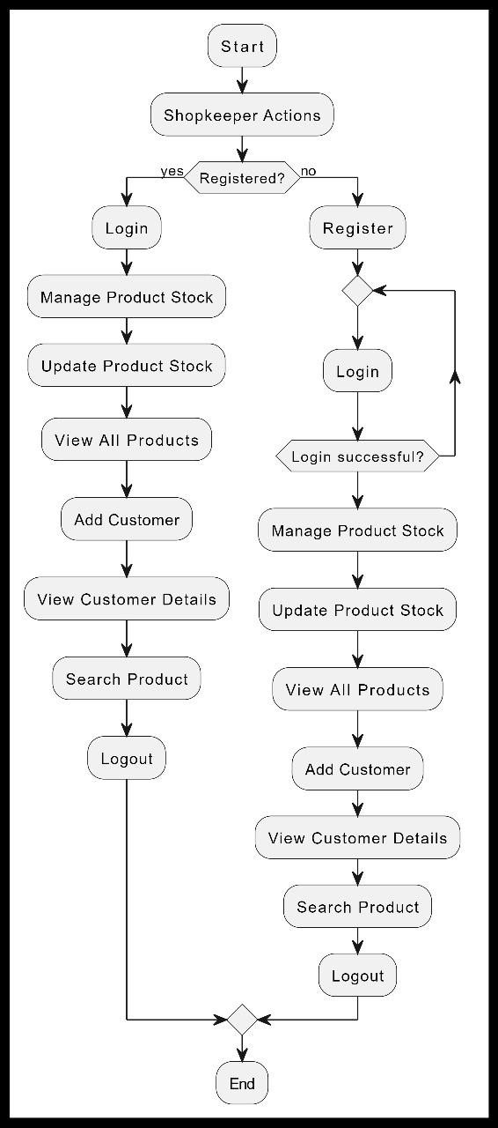
Flow-Chart

Slide 12
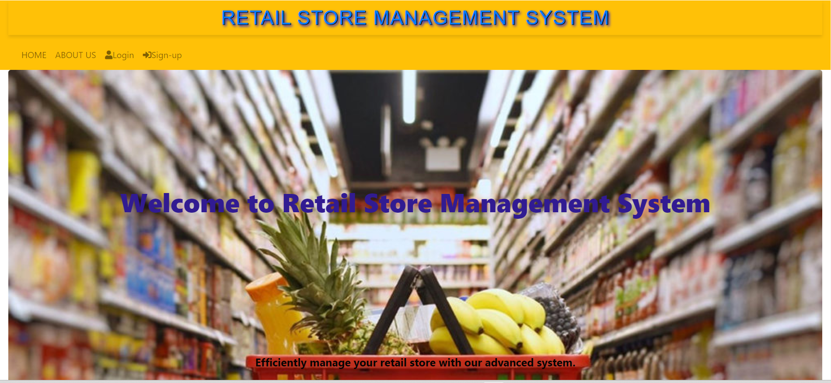
Output: Before login

Slide 13
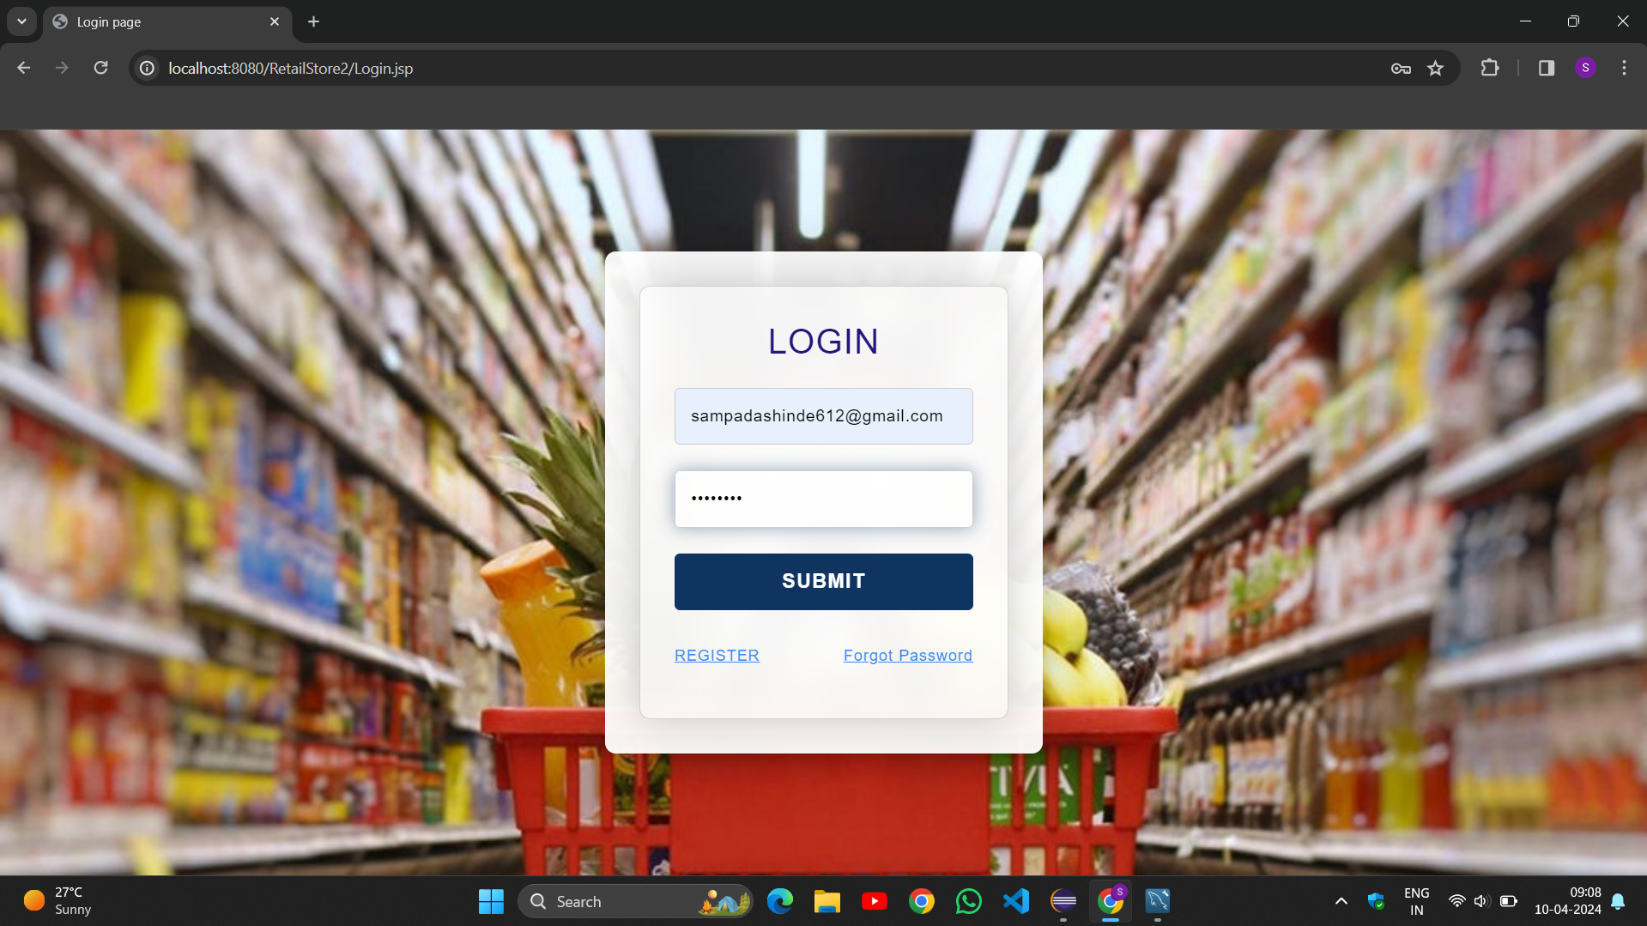
Login page

Slide 14
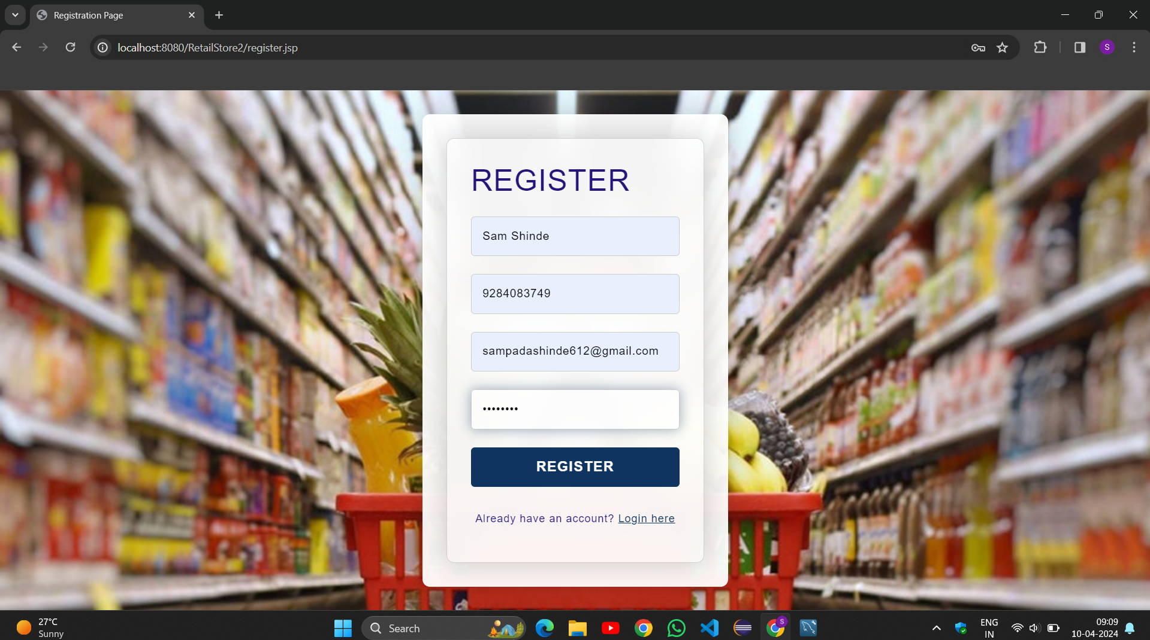
Register page

Slide 15
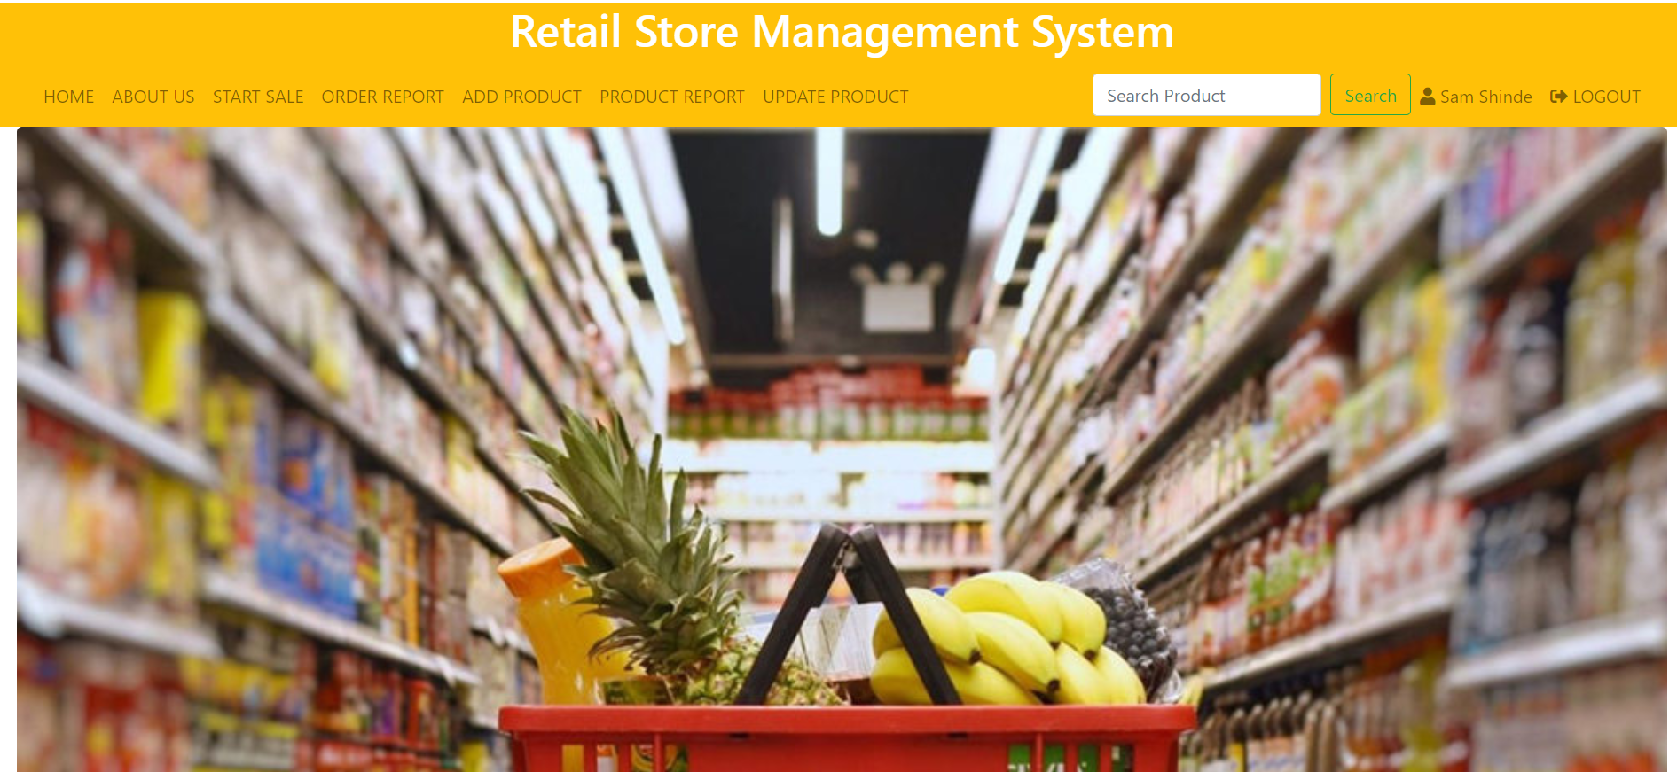
Output: After login

Slide 16
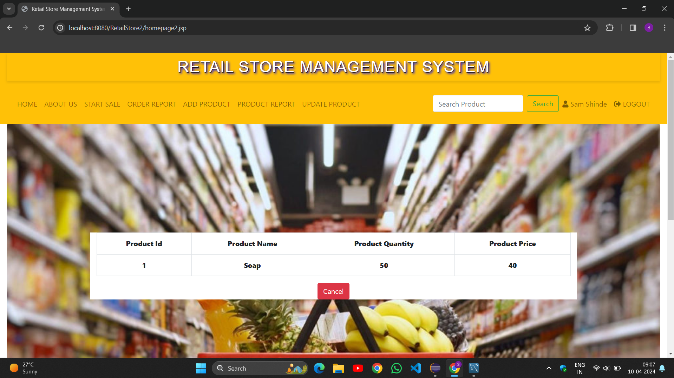
Search product

Slide 17
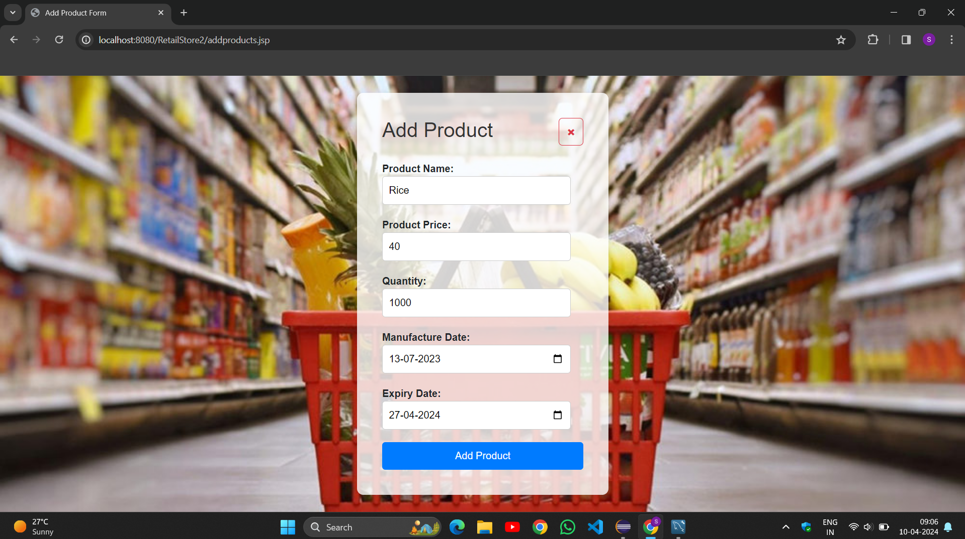
Add product

Slide 18
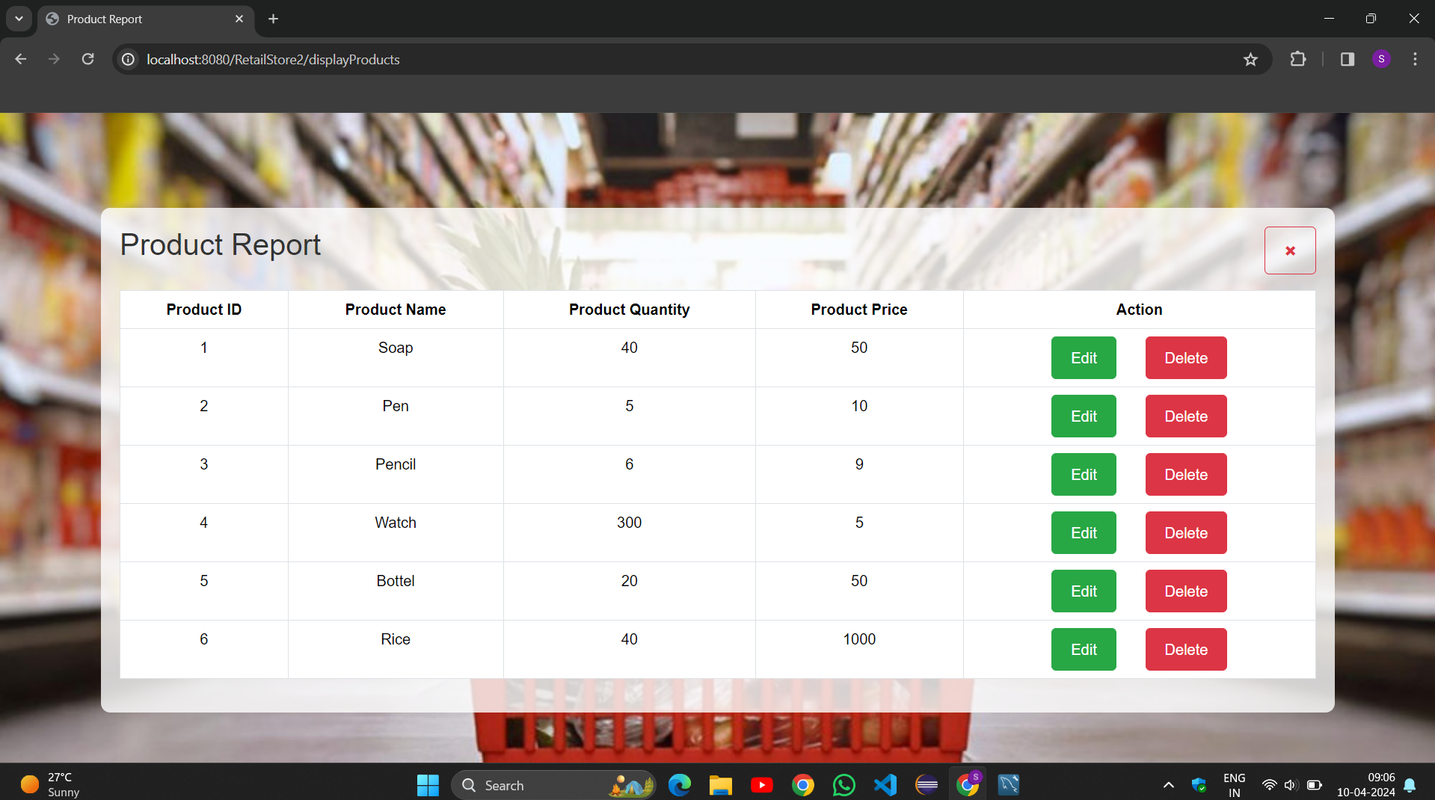
Product report

Slide 19
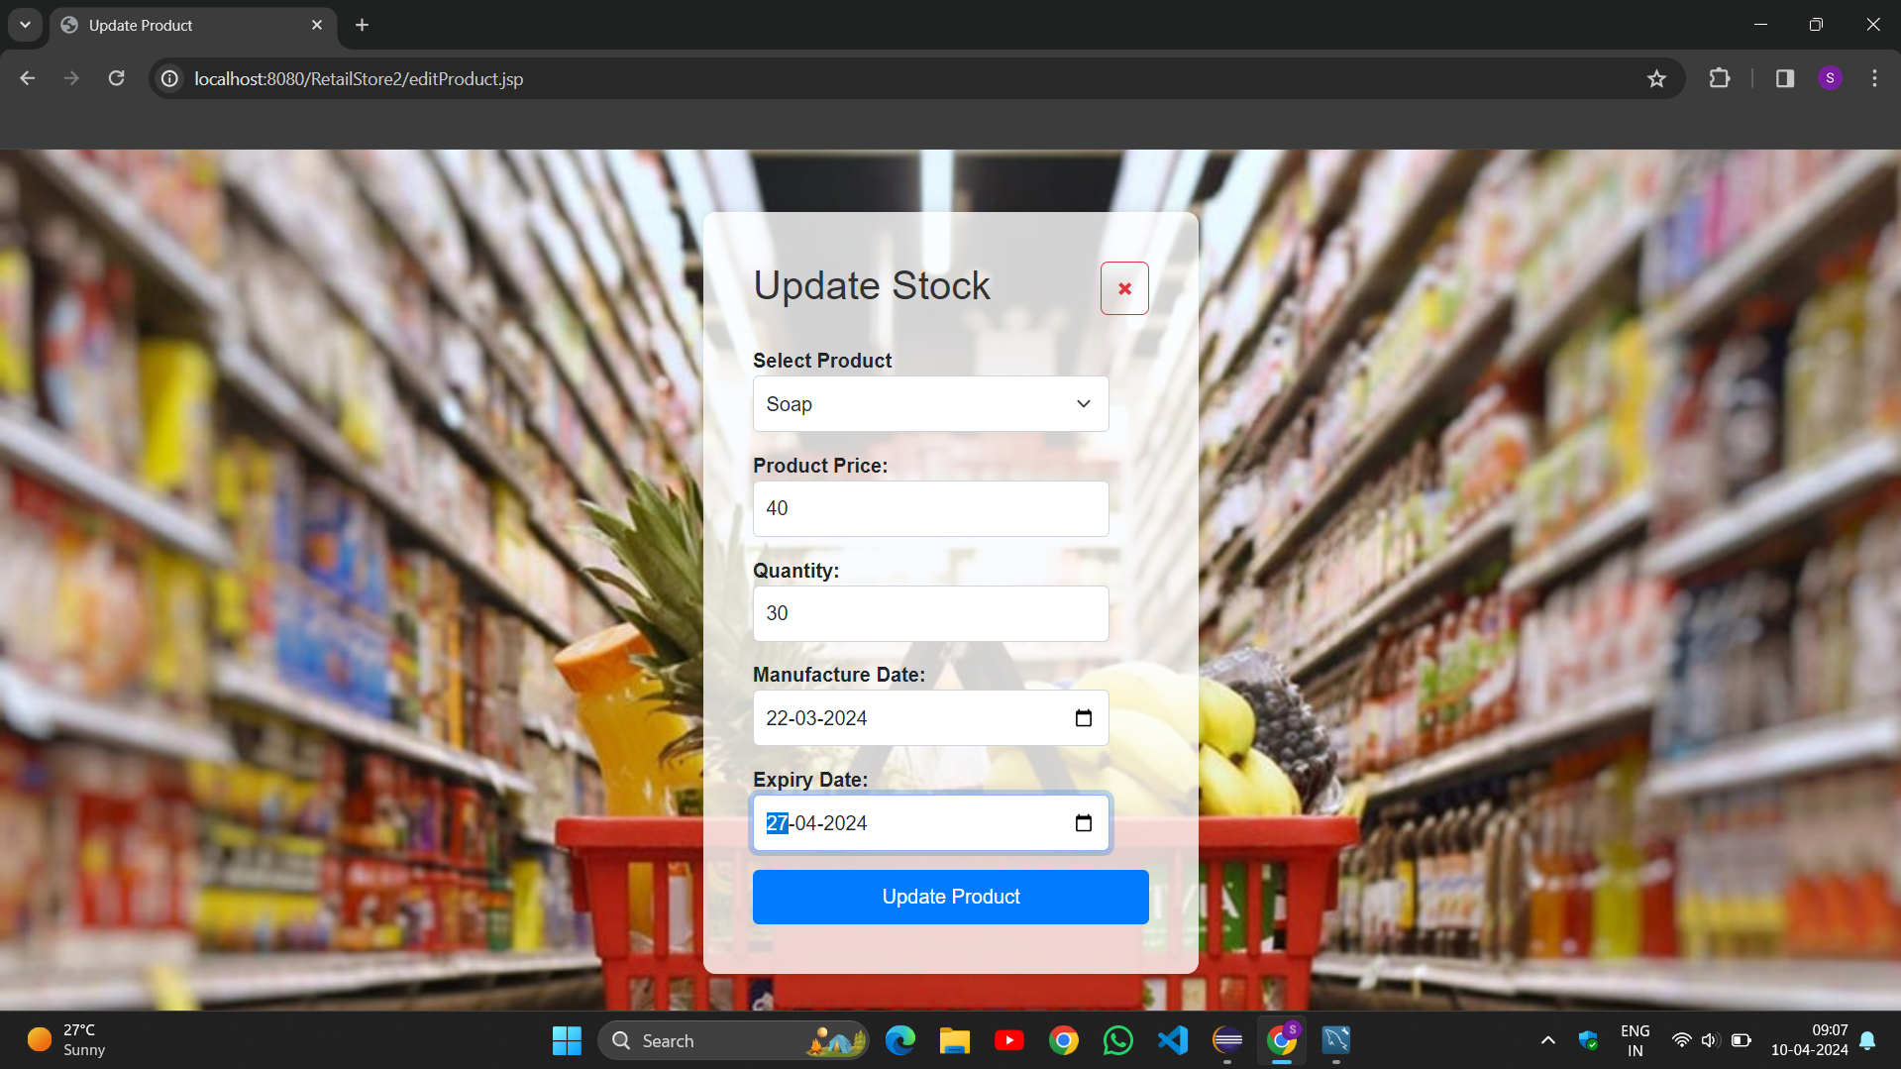
Update product

Slide 20
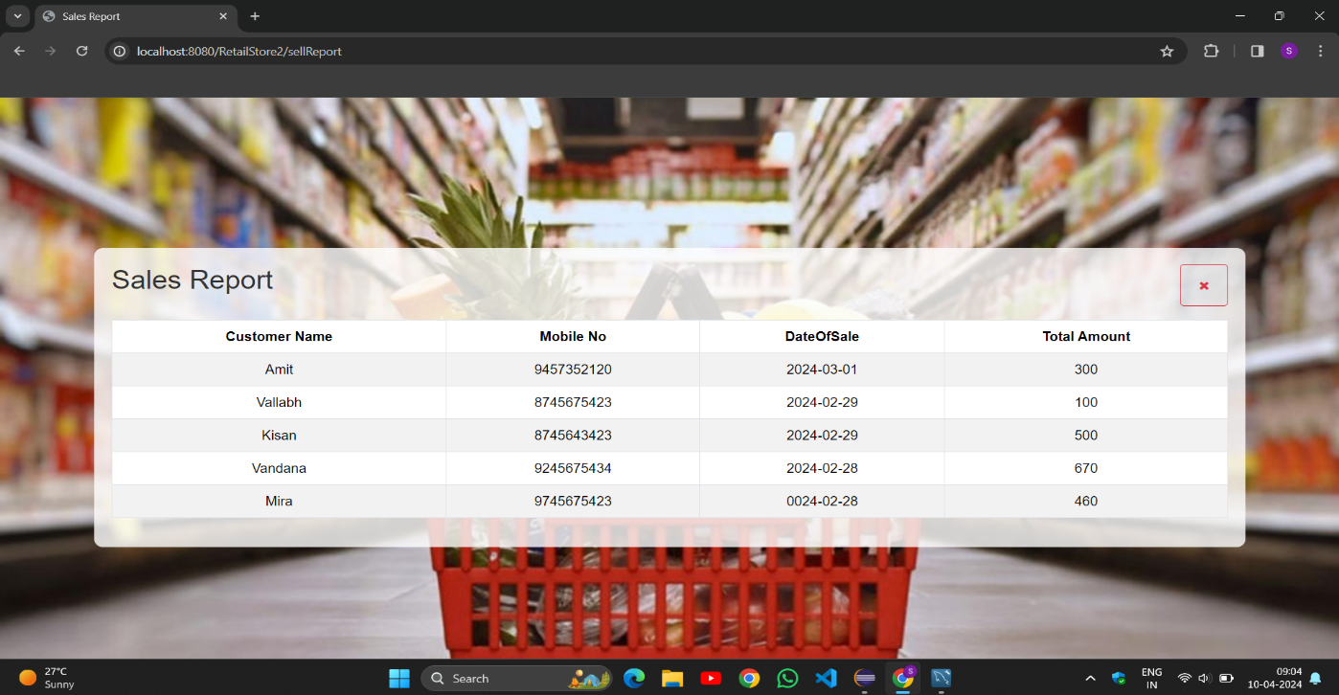
Sales Report

Slide 21
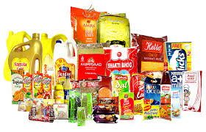
Advantages and disadvantages
Advantages:
Cost-effective.
Simple UI
Easy to Understand
Easy to store product record details.
Retailers have lower operating costs than wholesalers due to the cost of rent, utilities, and labour.
Disadvantages:
Encryption of sensitive data to protect against unauthorized access.
Limited functionality compared to larger systems.

Slide 22
Future enhancement
Lost and breakage
Online payment system
System flexible in any type.
Automatic create receipt.

Slide 23
Conclusion
The system is design to reduce human labor and efficiently maintaining the stock.
It provides flexible and powerful reports regarding customers, available products .
We can easily search information of any product.
We hope that it will help people to reduce both time and money.

Slide 24
Thank you

